Slide 1
SMART STICK FOR BLIND PEOPLE
MECHANICAL ENGINEERING Project Members:
CH.K.D TEJA VIKAS
B.PURNA CHANDRA RAO
K.SAMUEL VIJAY RAJ
P.KUSUMALATHA
N.SWETHA SRI

Slide 2
INTRODUCTION:
Since the running of daily life of blind people is very difficult. This project helps them to run their life as usual. They can make this project as a gadget or a device in their hands which detects the obstacle. This project is more efficient than the existing system with cheaper and accurate one. Here we are using arduino UNO board to perform this operation. To make the life to be as a normal one for the blind peoples this may be very helpful project for them. By making this as a gadget or a device in their hand they can easily judge an object by their own by knowing the buzzer sound. The system uses ultrasonic sensor as a wide range of field to detect an object with its higher detection range. Based on this project we take survey in our institution.

Slide 3
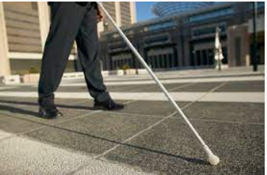
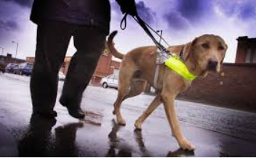
HISTORY:
With the improvement of the living standards of the people, we have become so materialistic that we have forgotten how the physically disabled people live a tough life.Earlierly they use a white cane and pet dogs which is very costly and difficult to maintain . To overcome those limitations this project will help. Nowadays there is a lot of technologies available for the visually challenged but our project is cheaper among them.

Slide 4
AIM:
The main aim of this project is to detect the obstacles with the help of the ultrasonic sensors to help the blind and make it easy for them to move around easily without any hassle.

Slide 5
PROPOSED SYSTEM:
The proposed system deals with the cheaper and effective obstacle detection with a wide range of coverage. The device includes the following components:
• Arduino UNO • Male Header
• Ultrasonic sensor • Jumper wires
• Buzzer • 5 mm LED: Red
• Power bank • Some elastics and stickers
• Female Header

Slide 6
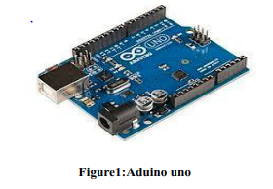
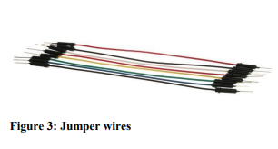
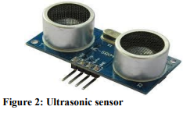
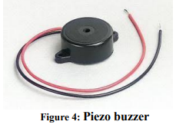
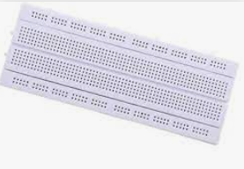
COMPONENTS :

Slide 7
ARDUINO UNO:
The Arduino is an open source hardware and software that can make a user to do effective operation in it.
The Arduino is a microcontroller. These microcontroller devices help in sensing and controlling the objects in the real-time situations and environment.
These boards are available cheaper in the market. There are a number of inventions performed in it and still it is going on.
The board is equipped with sets of digital and analog input/output (I/O) pins that may be interfaced to various expansion boards (shields) and other circuits .

Slide 8
ULTRASONIC SENSORS:
An ultrasonic sensor is an instrument that measures the distance to an object using ultrasonic sound waves. An ultrasonic sensor uses a transducer to send and receive ultrasonic pulses that relay back information about an object proximity.The ultrasonic sensor consists of transmitter, receiver and transceiver. The transmitter convert electrical signal into soundwaves. The receiver converts the soundwaves into electrical signal again. The transceiver performs both the receiver and transmitter operations. It also has crystal oscillators in it. It will perform the stabilization operation in the ultrasonic sensor.

Slide 9
JUMPER WIRE:
The jump wires are also known as jumper wire used to connect devices. Without soldering we can make an easier connection with devices. These are available as a set of wire that has the pin on both sides. These wires are used as making their one end connecting to the corresponding device and another end to the breadboard.
PIEZO BUZZER:
The piezo buzzer is an electronic device which generates sound through it. The buzzer is used as an indication to the user. It is used in the car reversing system and braking system as an indication. It is based on the principle of piezoelectricity discovered in 1880 by Jacques and Pierre Curie

Slide 10
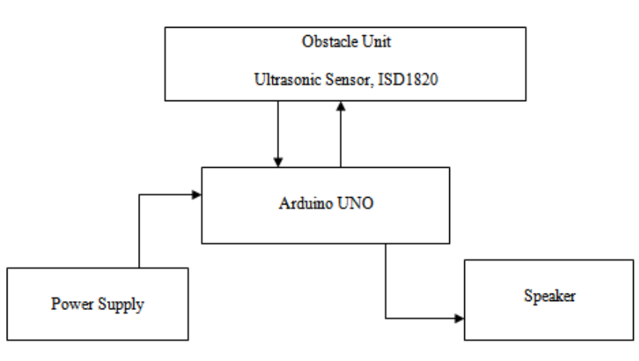
BLOCK DIAGRAM:

Slide 11
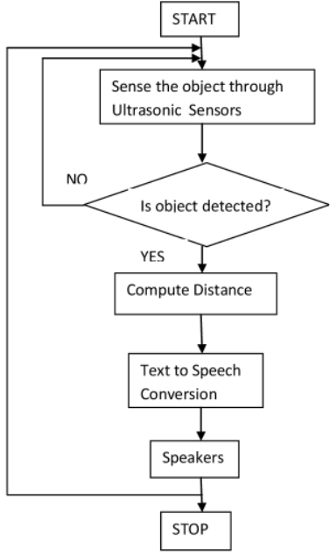
FLOW CHART:

Slide 12
CONCLUSION:
Our project is an innovation which helps the blind to move around and go from one place to another place with speed and confident by knowing the near by obstacles using the help of our wearable band which produces ultrasonic waves which notify them with buzzer sound and vibration, The one of the main peculiarity of this innovation is it is affordable for everyone. This device will the blind to navigate without holding a stick ,Which is a bit annoying for them.They can simple wear it as a band or as a cloth and it can function very accurately and they can only need a very little training to use it.

Slide 13


